Slide 1
// Discover to Manage
Unified Data Management

Slide 2
Agenda
1
Company overview
2
Raynet Unified Data Platform
3
Use cases
4
Your contact

Slide 3
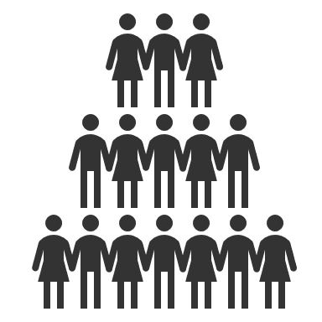
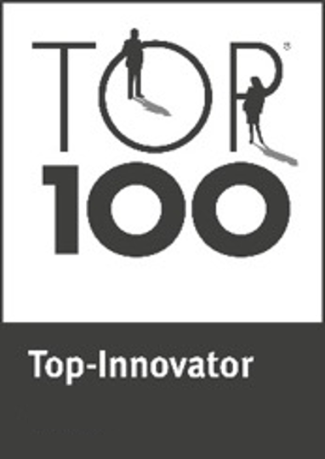
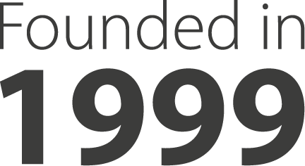
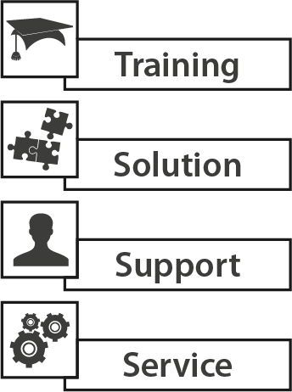
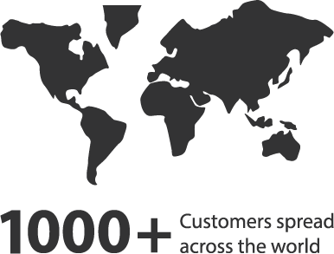
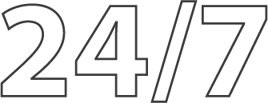
Company overview
Recognitions for Gartner Magic Quadrants
Software Asset Management Tools 2020 &
Unified Endpoint Management Tools 2020 & 2021
Midmarket Context UEM Tools 2022
Paderborn, Germany (HQ)
Regensburg, Germany
Berlin, Germany
Ingolstadt, Germany
Istanbul, Turkey
Chicago, USA
Szczecin, Poland
Birmingham, UK
140 +
Employees
Solutions portfolio

Slide 4
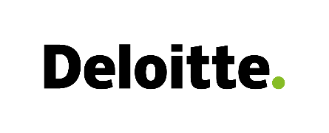
Our partners & customers
Partners
Customers

Slide 5
Best Practice Workflow
Discover to Manage the Application Lifecycle Management

Slide 6
// Discover to Manage
Raynet Unified Data Platform

Slide 7
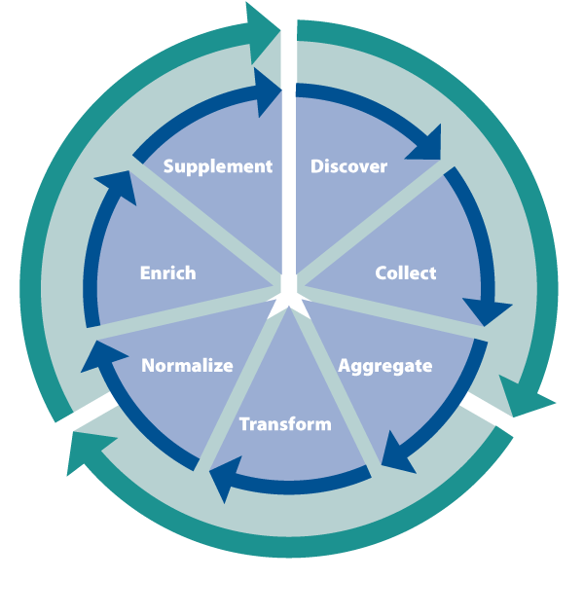
Raynet Unified Data Platform

Slide 8
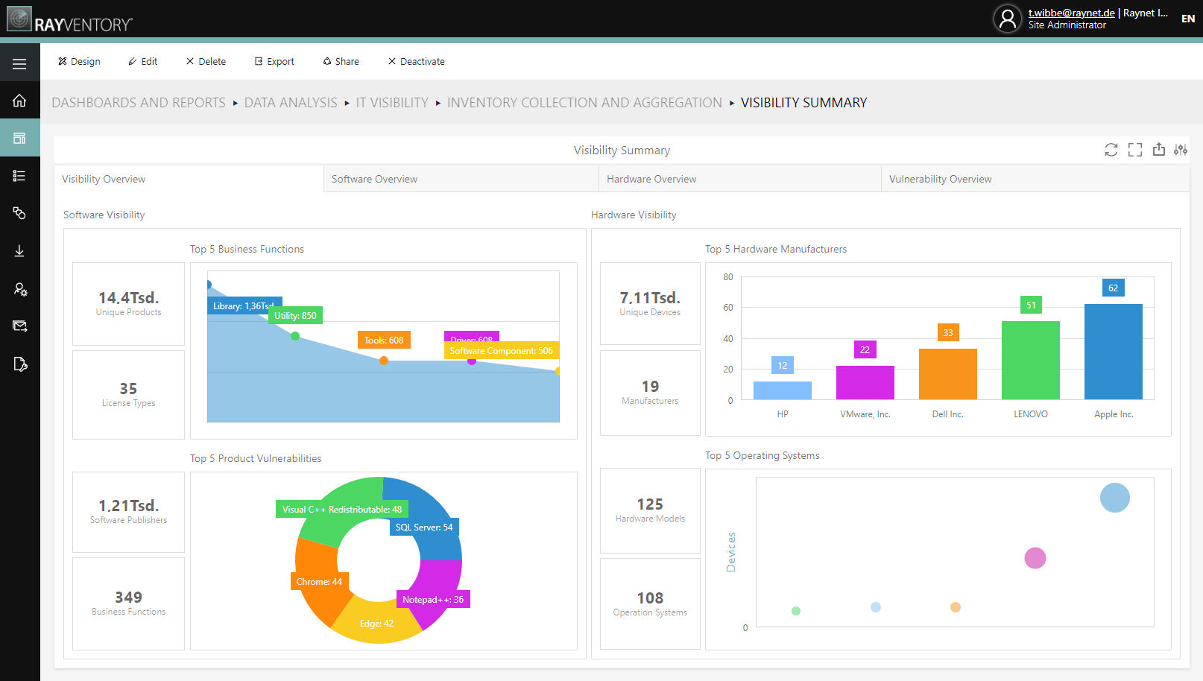
Raynet Unified Data Platform
Two powerful technologies provide an automated end-to-end process:
Raynet Unified Data Platform combines complete IT visibility and comprehensive data enrichment as well as data transformation in one central solution. You get total transparency, coupled with continuous monitoring and a high-quality database of your IT assets.
More information

Slide 9
Raynet Unified Data Platform
Technology Catalog
Data Management
Automated product recognition through advanced AI technology
With our comprehensive technology catalog, we normalize, categorize, and enrich your data set with essential information. This gives you insights that are not possible with conventional solutions.
End-of-Life and End-of-Support information
CVE vulnerabilities with severity
Classification & license type
Business function & product family
Latest software version
Intelligent ETL technology as the basis for essential key figures Our advanced IT visibility and data management solution gathers and transforms your data from hundreds of different data sources to provide you with detailed reporting on key KPIs afterwards.
Extract & transform
Enrich & normalize
De-duplicate & categorize
Visualize & manage
Monitor & report
More information
More information

Slide 10
// Discover to Manage
Use cases

Slide 11
Raynet Unified Data Platform
Use Cases
// CMDB Data Enrichment Enrich your data for strategic IT management
// End-of-Life & End-of-Support Optimize your software portfolio & proactively protect it
// Discovery & Inventory Keep track of your entire hardware and software landscape
// SaaS Management Eliminate unnecessary software costs and be in control of your licenses
// Vulnerability Monitoring Improve your IT security proactively and sustainably
// Software Asset Management Reduce software costs and audit risks in your IT environment
// Data Normalization Gain new business insights by normalizing your data
// Application Rationalization Reduce your software spread while maintaining business functionality

Slide 12
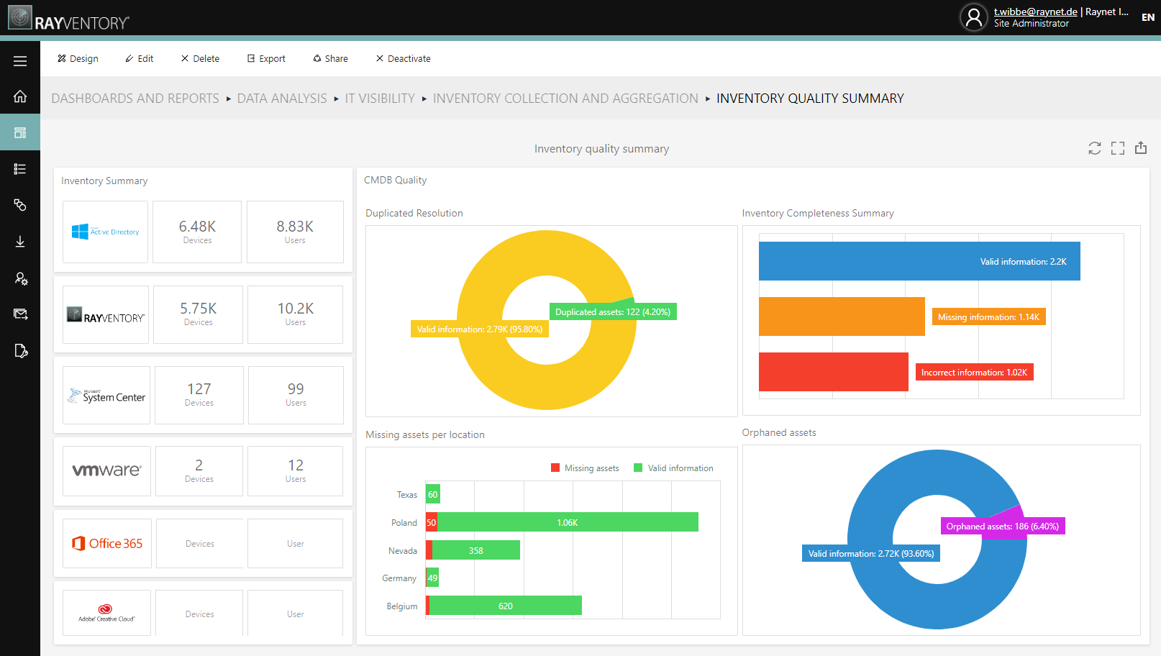
CMDB Data Enrichment
Enrich your data for strategic IT management:
More than 71% of organizations report that data issues are impacting the effectiveness of their CMDB. As a result, 40% of enterprise initiatives fail due to poor data due to poor data quality or incomplete CMDB.
More information

Slide 13
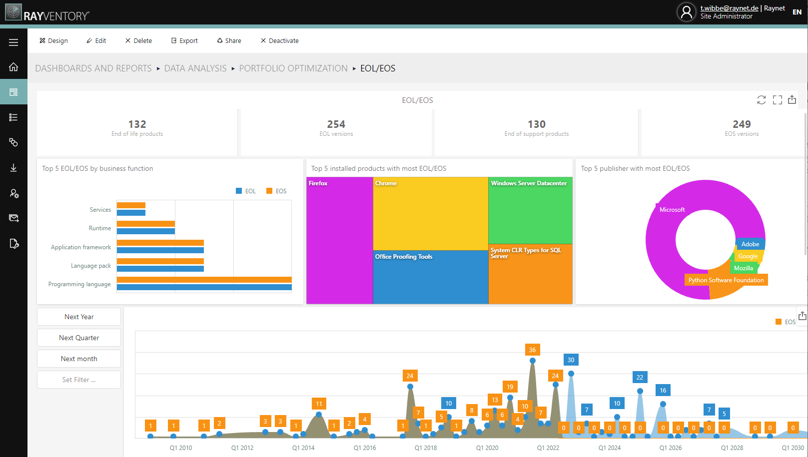
End-of-Life & End-of-Support Monitoring
Optimize your software portfolio & proactively protect it:
Gaps in End-of-Life (EoL) and End-of-Support (EoS) data can leave your infrastructure vulnerable to attacks. Protect your IT with fully automated End-of-Life & End-of-Support Monitoring.
More information

Slide 14
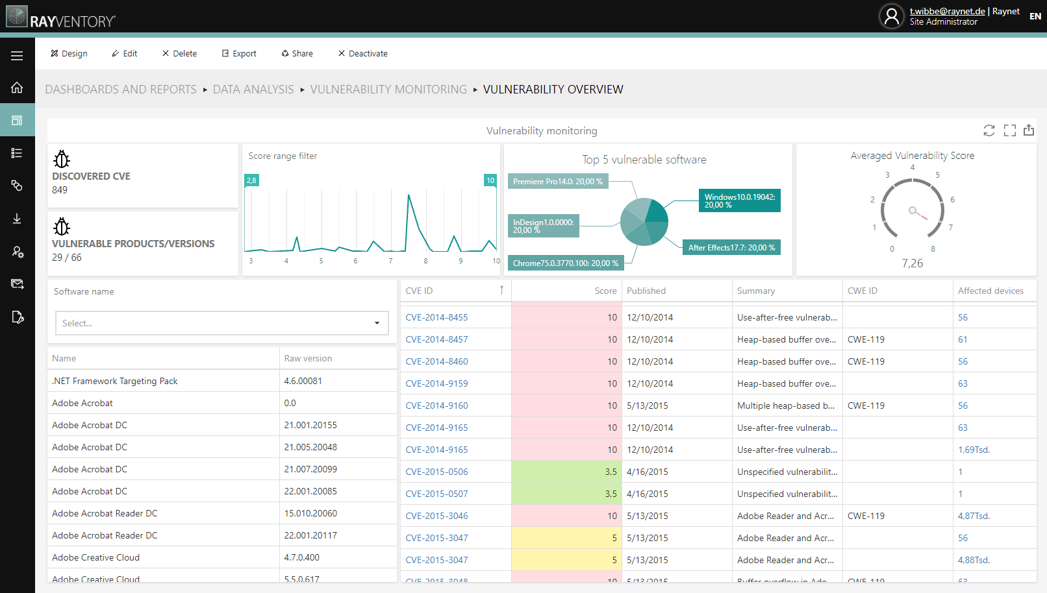
Vulnerability Monitoring
Improve your IT security proactively and sustainably:
Protect your IT landscape from cyberattacks and prioritize measures to improve your IT security. Identify vulnerable software and be plan for the unplanned.
More information

Slide 15
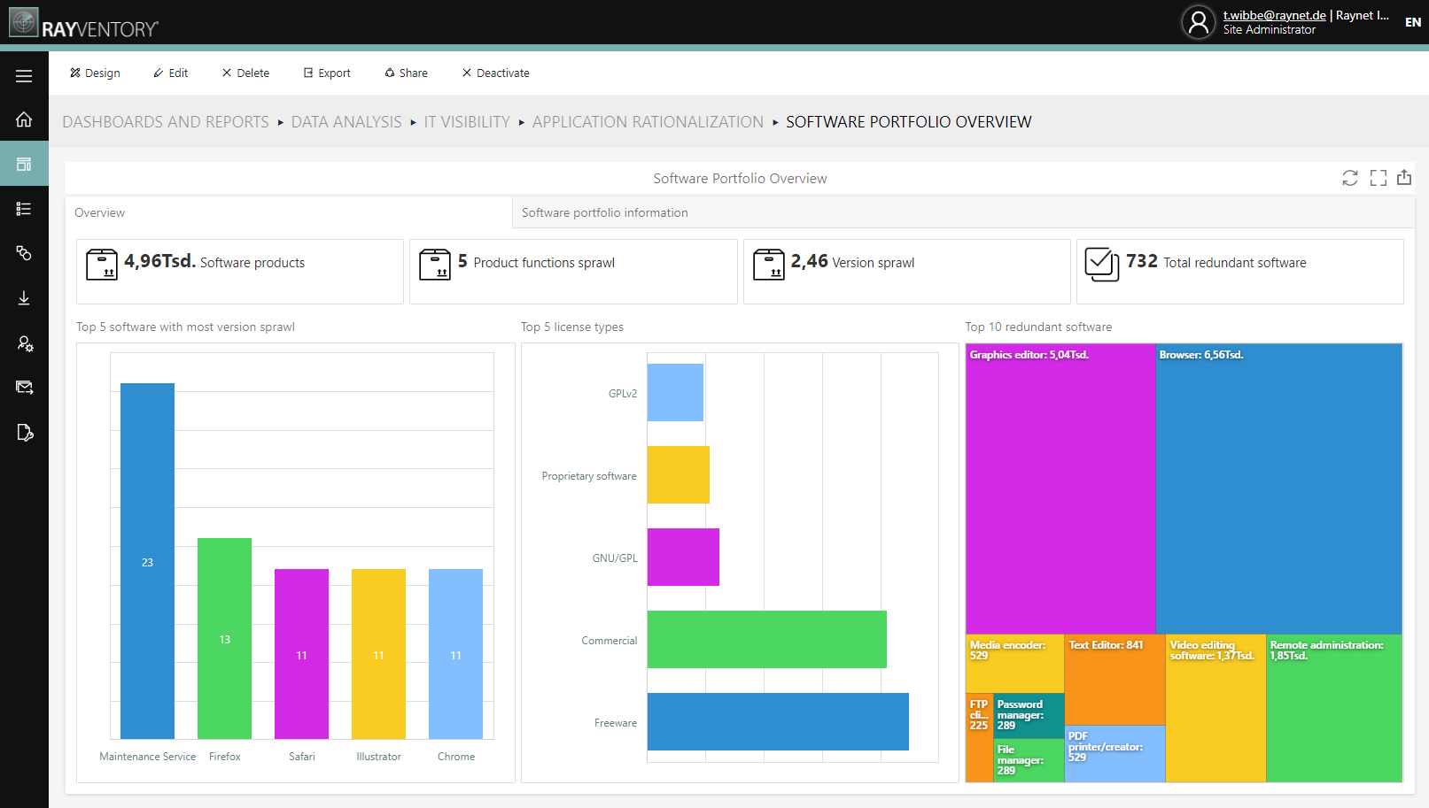
Application Rationalization
Reduce your software spread while maintaining business functionality:
Companies pay too much in license fees and operating costs for their software. Identify unnecessary costs and optimize your portfolio based on data-driven recommendations.
More information

Slide 16
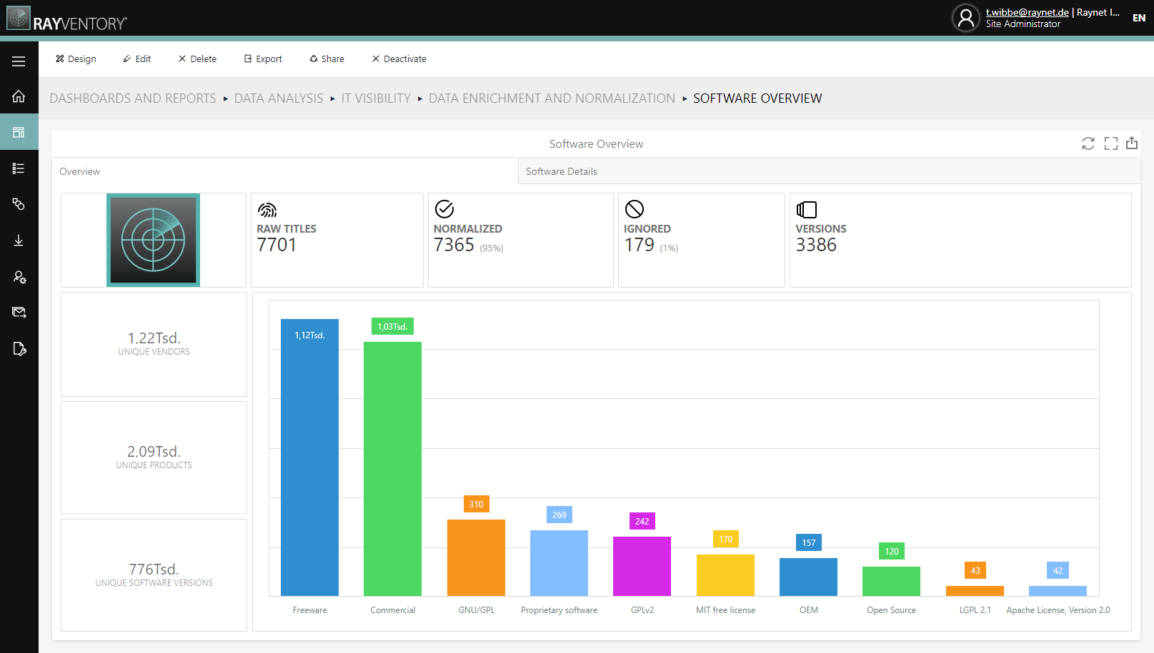
Data Normalization
Gain new business insights by normalizing your data:
Constant technological change requires constant action to gather & store relevant IT data. Normalize and enrich your data automatically to give it more value.
More information

Slide 17
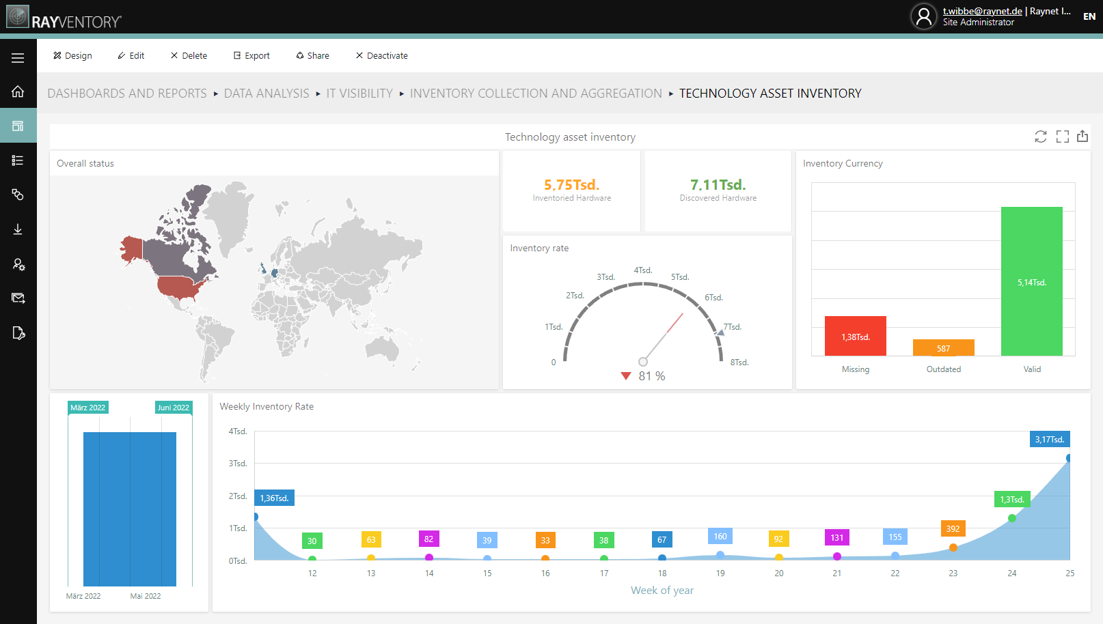
Discovery & Inventory
Keep track of your entire hardware and software landscape:
Get a complete overview and holistic transparency of your centralized or decentralized hardware and software. Lay the foundation, for example, to be prepared for audits and much more.
More information

Slide 18
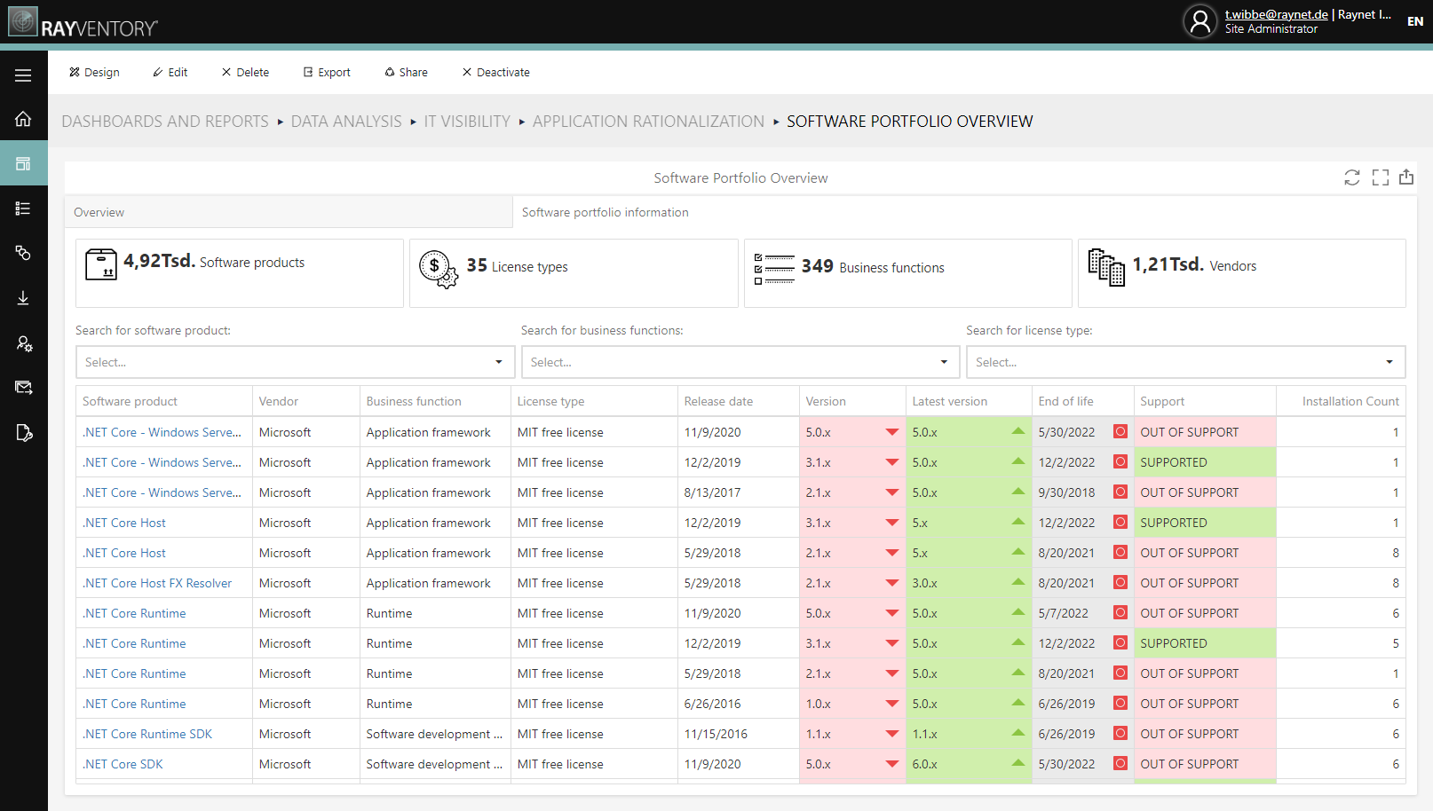
Software Asset Management
Reduce software costs and audit risks in your IT environment:
See your license status and plan sustainably for the future of your portfolio. Optimize not only your software costs but improve your business results through strategic software asset management.
More information

Slide 19
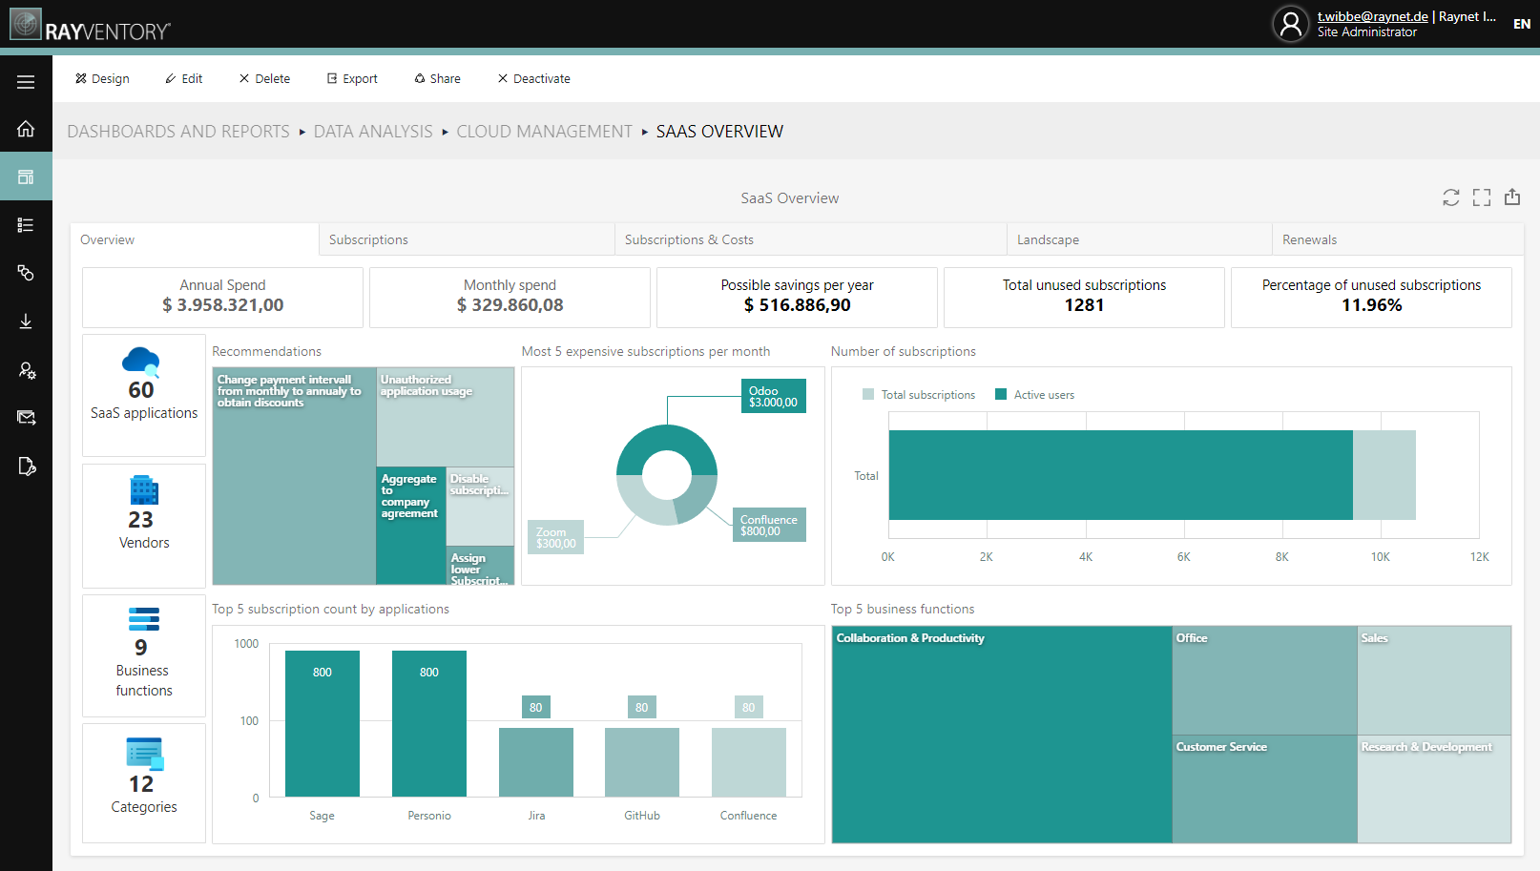
SaaS Management
Eliminate unnecessary software costs & control your licenses:
Procuring SaaS applications is easy, flexible and increases productivity, but it can also increase your costs. Get a complete overview of your SaaS licenses to get more out of your investment.
More information

Slide 20
// Discover to Manage
Your contact

Slide 21
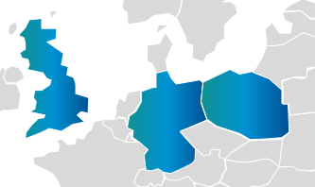
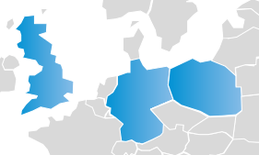
Your contact
Paderborn (HQ)
Szczecin
Birmingham
Ingolstadt
Berlin
Regensburg
Paderborn
Ragıp Aydın
CEO & Managing Director
T +49 5251 54009-0
r.aydin@raynet.de
Chicago
Tokyo
Istanbul
Stay connected
Paderborn (HQ), GER | Regensburg, GER | Berlin, GER | Ingolstadt, GER
Istanbul, TUR | Chicago, USA | Szczecin, PL | Birmingham, UK | Tokyo, JPN

